Slide 1
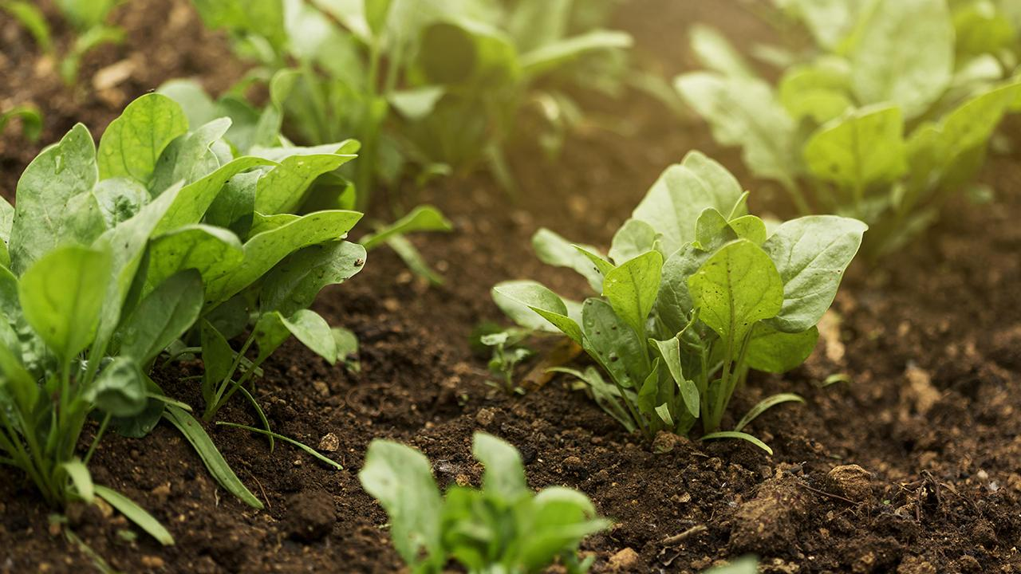
Detection of a Potato Disease (Early Blight) Using Artificial Intelligence [1]
Hassan Afzaal , Aitazaz A. Farooque , Arnold W. Schumann , Nazar Hussain , Andrew McKenzie-Gopsill , Travis Esau, Farhat Abbas and Bishnu Acharya
Presented by-
Team no - 09
Abanti Chakraborty Shruti ID: 22366034
Ehsanur Rahman Rhythm
Md. Humaion Kabir Mehedi

Slide 2
Table of contents
Introduction
Concept Flowchart
01
04
Materials and Methods
02
05
Future Works
Results
03

Slide 3
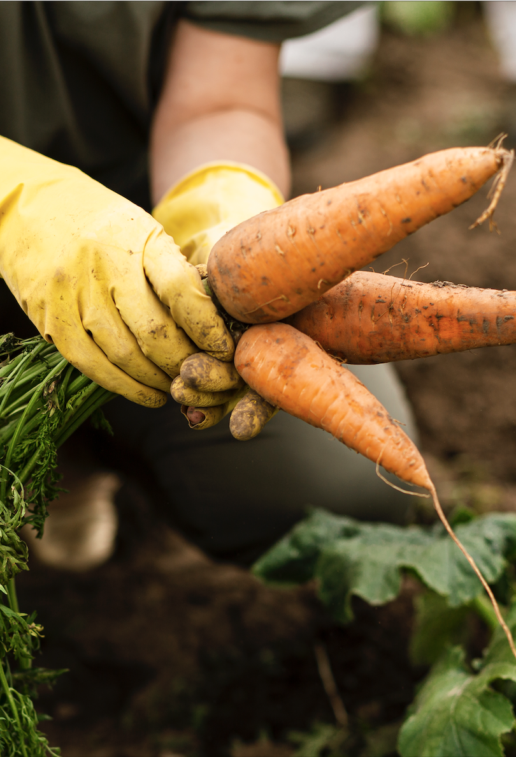
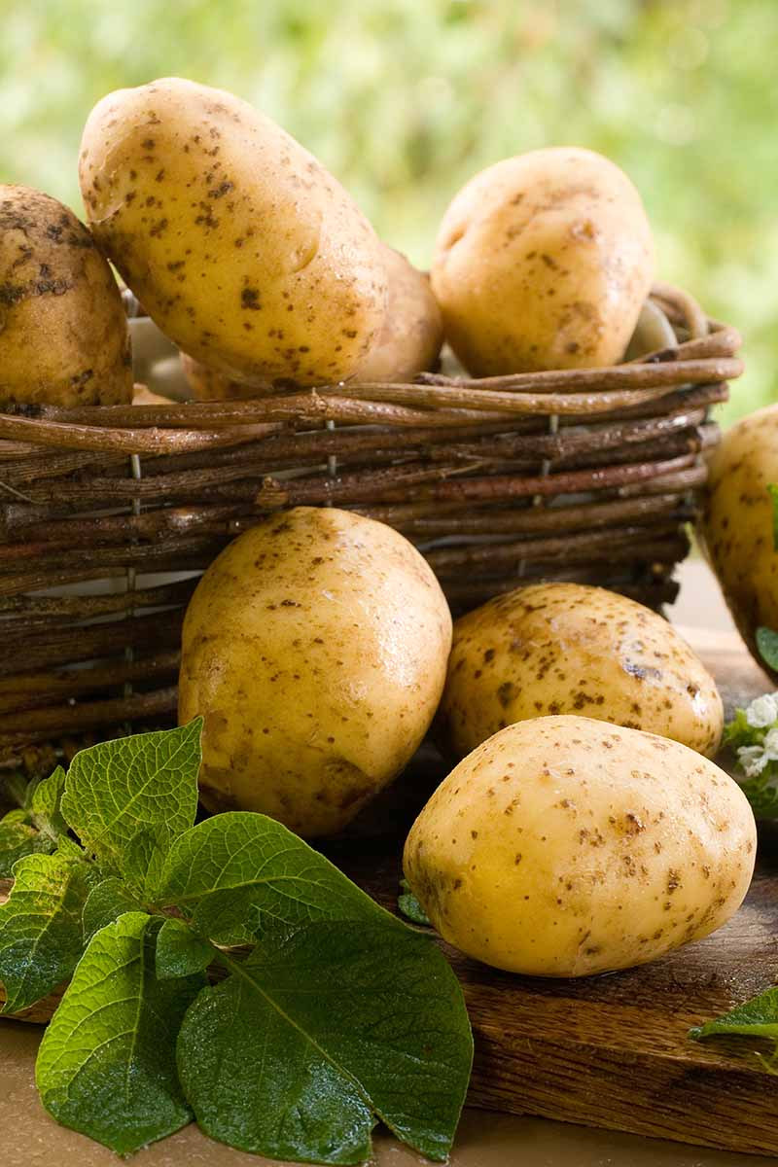
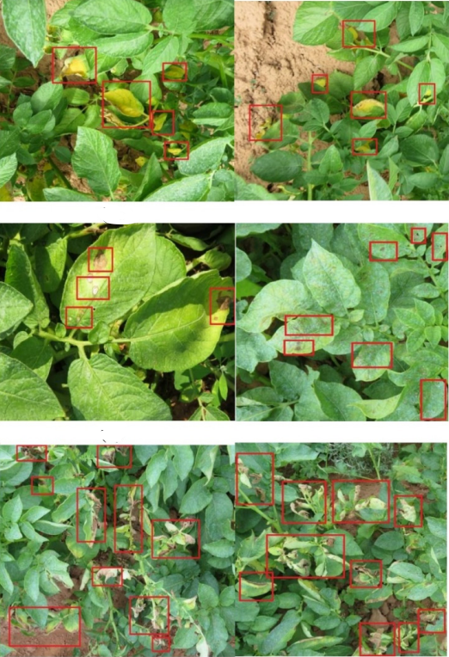
Introduction
Identify the early blight disease in real-time for potato production system
Efficient crop management to provide economic and environmental benefits
Evaluate the potential of using artificial intelligence based convolutional neural networks
Compare three ages of CNNs (GoogleNet—old, VGGNet—mid-age, and EfficientNET—new) for identification of early blight disease
Assess their adequacy in developing a smart sprayer for the targeted application of fungicides

Slide 4
Material and Methods
Study Site and Data Collection
5199 data collected from 4 sites of Canada
Multistage Disease Comparison
3 separate experimental groups for accurate identification
Model Training and Hyperparameter Tuning
3 CNN’s with Adam optimizer were selected
Statistical Analysis and Inference Time
Dell Latitude 5580 recorded time for a batch size of 1

Slide 5
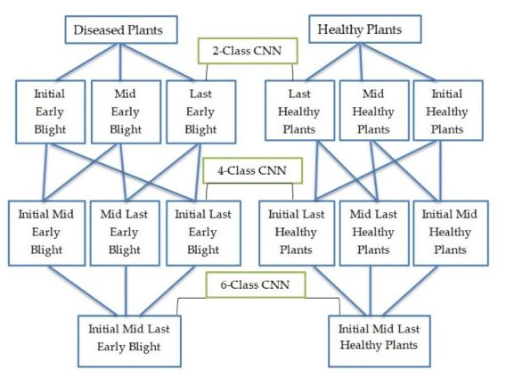
Concept Flowchart

Slide 6
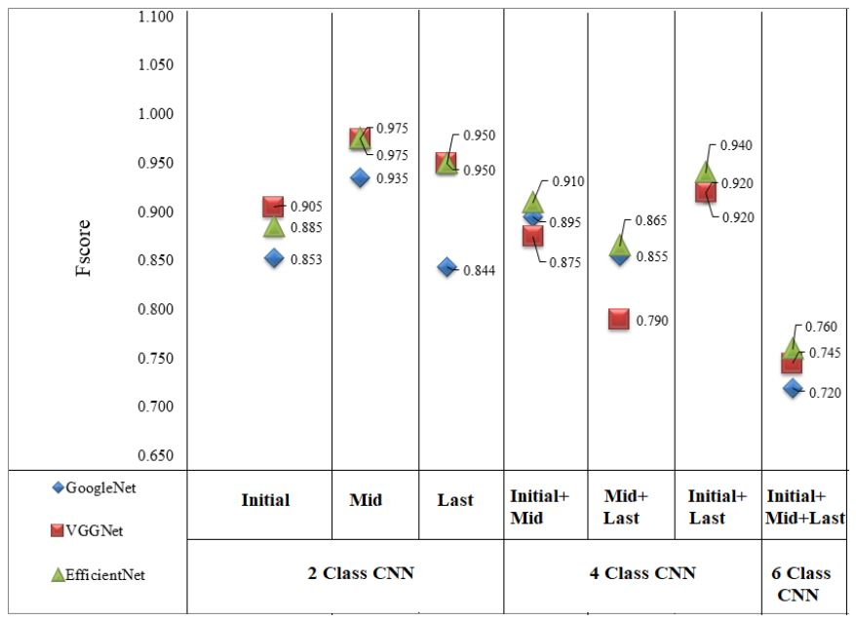
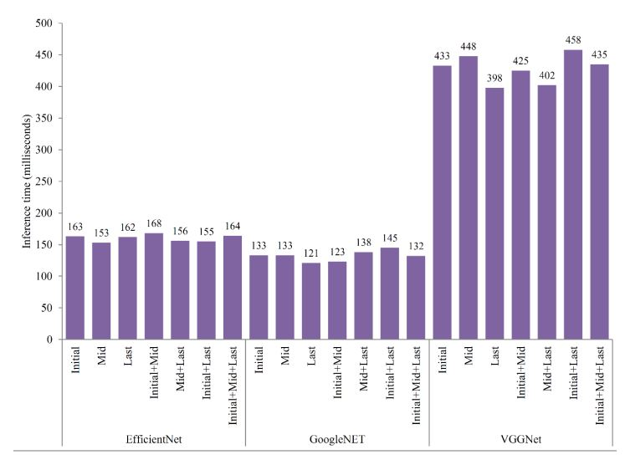
Results

Slide 7
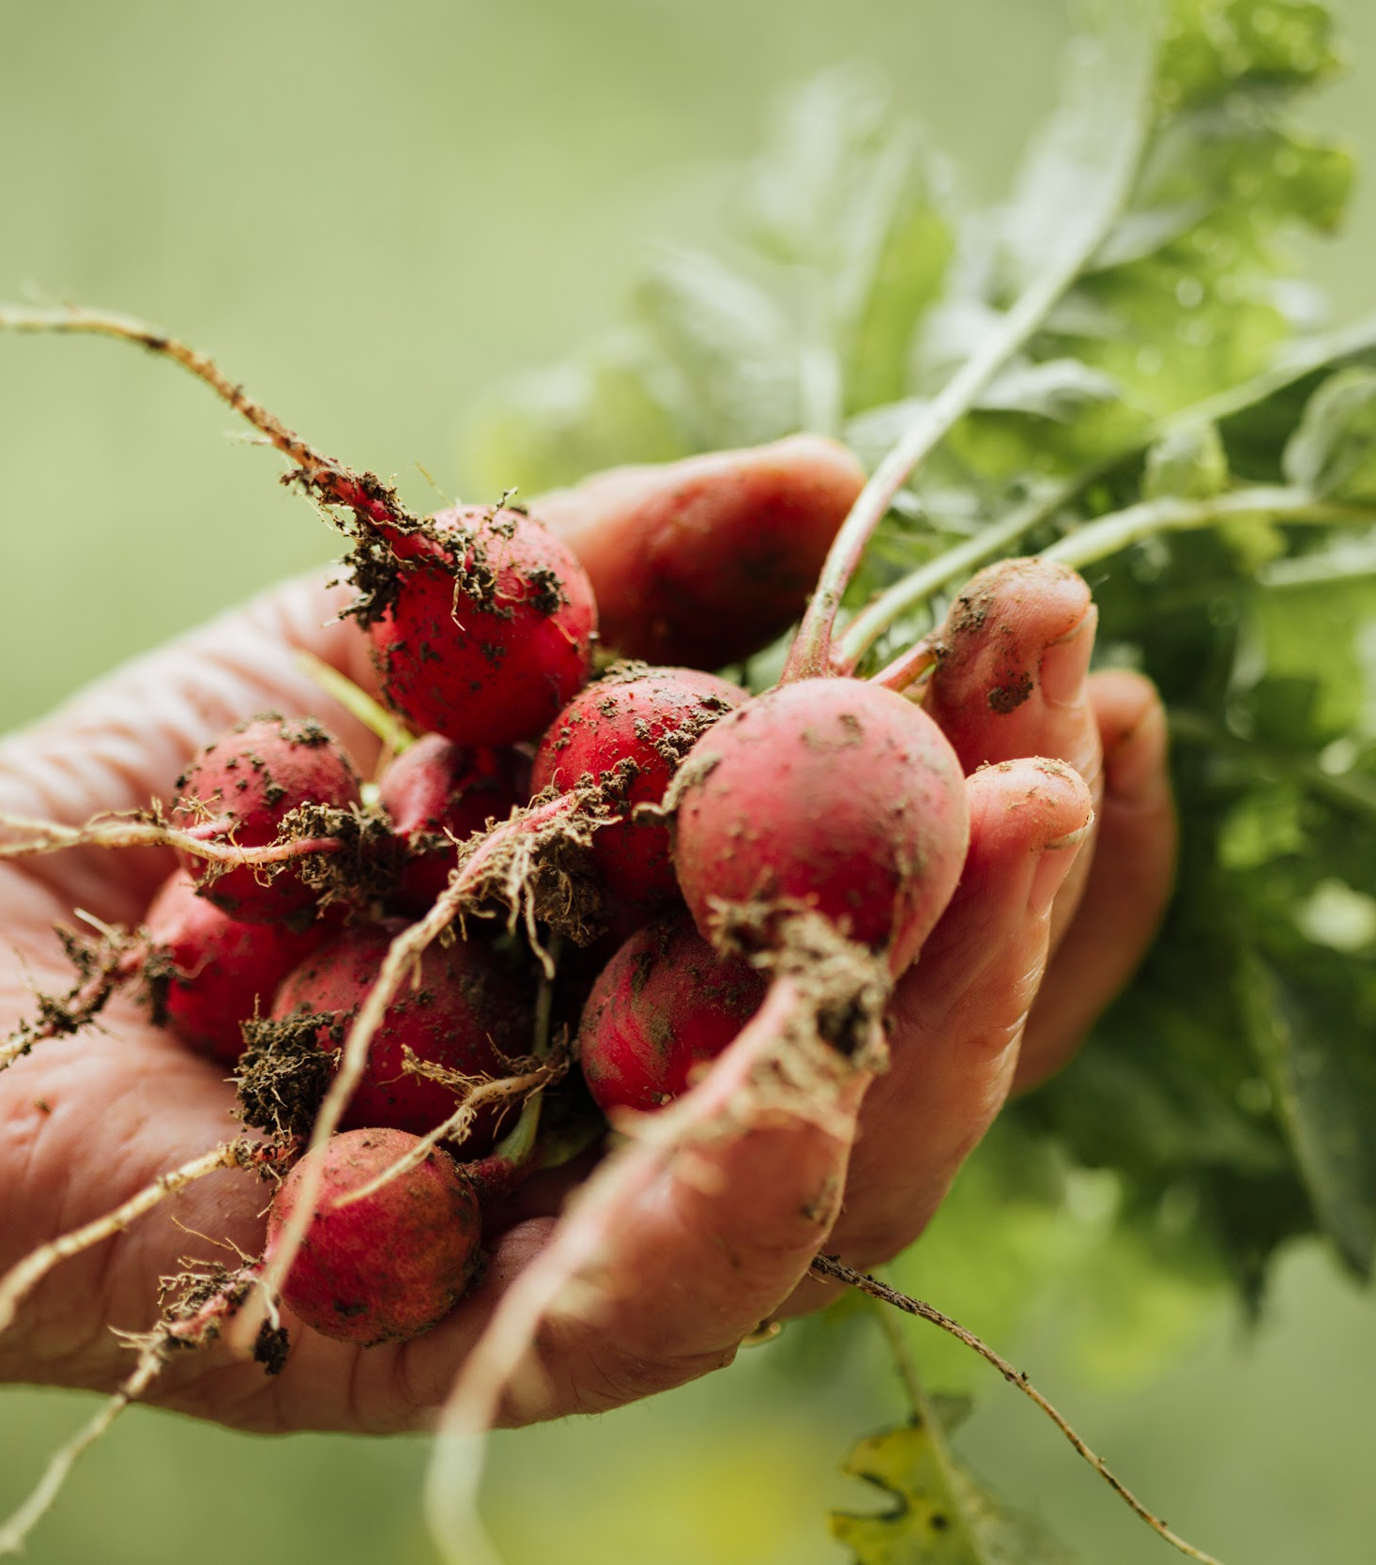
Future Works
The trained EfficientNET CNN will be deployed and integrated into hardware
Developed sprayer will be calibrated before installation
Real-time image acquisition, processing, and delay time will be calculated to accurately
Extensive lab and field evaluations will be performed
Other herbicides and fungicides applications will be explored

Slide 8
Reference
[1] Afzaal, H., Farooque, A.A., Schumann, A.W., Hussain, N., McKenzie-Gopsill, A., Esau, T., Abbas, F. and Acharya, B., 2021. Detection of a potato disease (early blight) using artificial intelligence. Remote Sensing, 13(3), p.411.

